Slide 1
Cluster Validity
For supervised classification we have a variety of measures to evaluate how good our model is
  Accuracy, precision, recall
For cluster analysis, the analogous question is how to evaluate the “goodness” of the resulting clusters?
But “clusters are in the eye of the beholder”!
Then why do we want to evaluate them?
  To avoid finding patterns in noise
  To compare clustering algorithms
  To compare two sets of clusters
  To compare two clusters

Slide 2
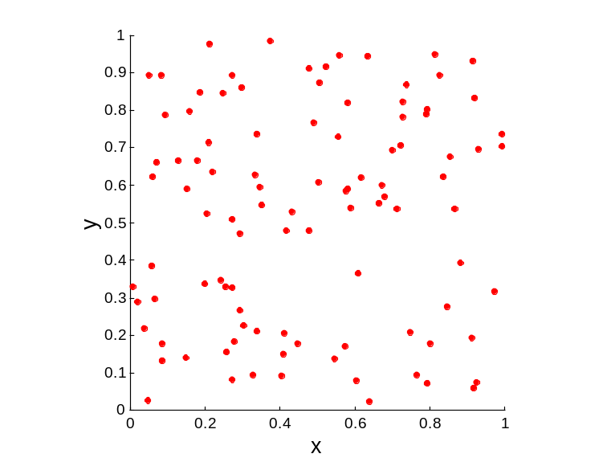
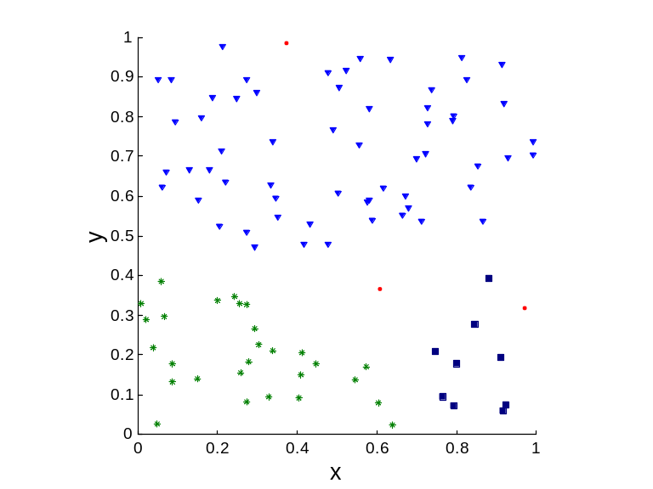
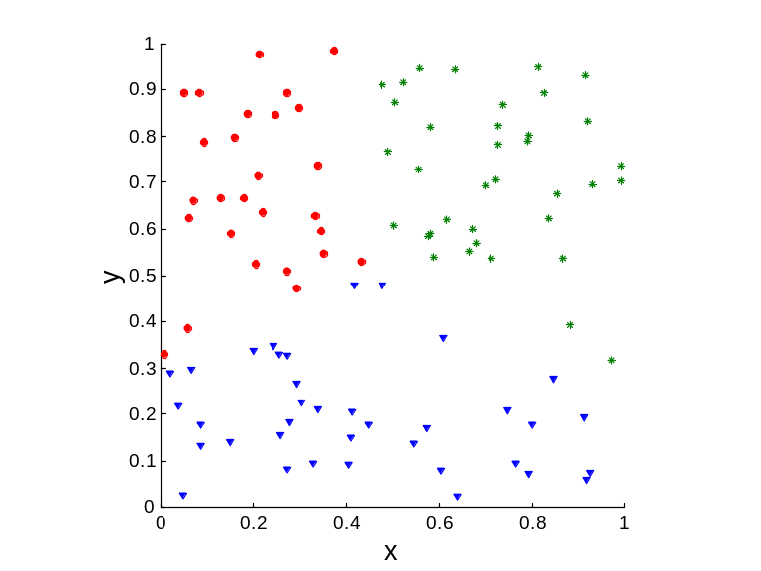
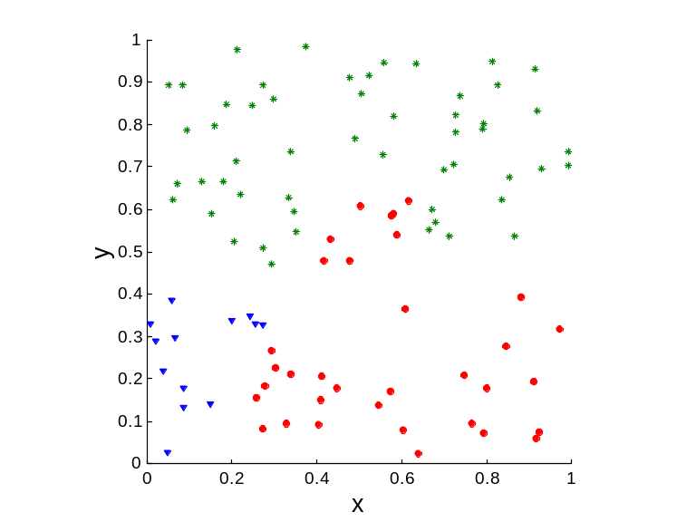
Clusters found in Random Data
Random Points
DBSCAN
K-means
Complete Link

Slide 3
Measures of Cluster Validity
Numerical measures that are applied to judge various aspects of cluster validity, are classified into the following three types.
  External Index: Used to measure the extent to which cluster labels match externally supplied class labels.
    Entropy
  Internal Index: Used to measure the goodness of a clustering structure without respect to external information.
    Sum of Squared Error (SSE)
  Relative Index: Used to compare two different clusterings or clusters.
    Often an external or internal index is used for this function, e.g., SSE or entropy
Sometimes these are referred to as criteria instead of indices
  However, sometimes criterion is the general strategy and index is the numerical measure that implements the criterion.

Slide 4
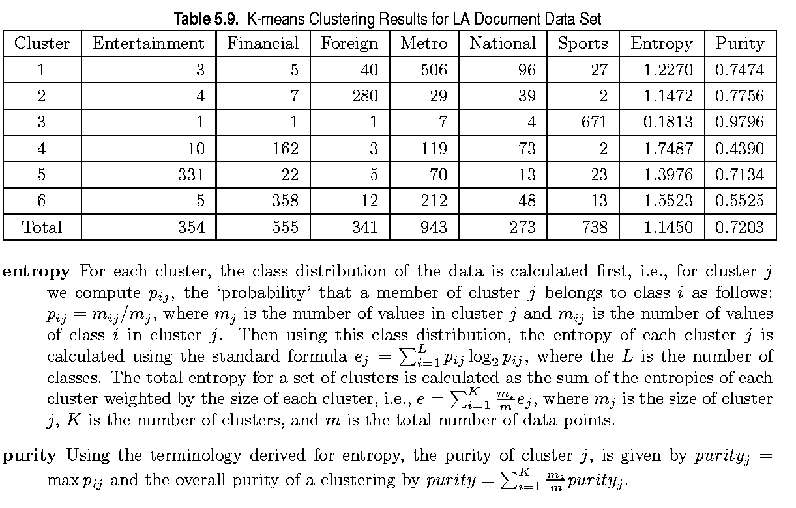
External Measures of Cluster Validity: Entropy and Purity

Slide 5
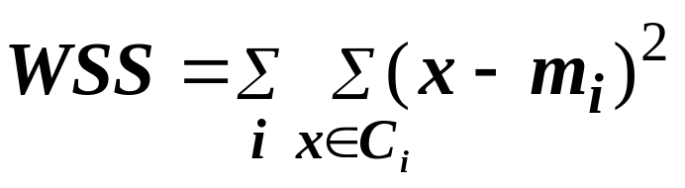
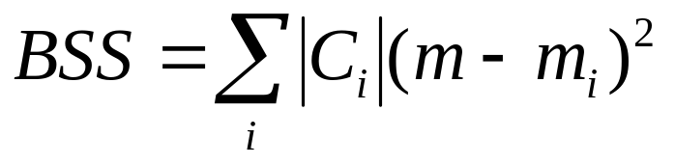
Internal Measures: Cohesion and Separation
Cluster Cohesion: Measures how closely related are objects in a cluster
  Example: SSE
Cluster Separation: Measure how distinct or well-separated a cluster is from other clusters
Example: Squared Error
  Cohesion is measured by the within cluster sum of squares (SSE)
  Separation is measured by the between cluster sum of squares
      Where |C_{i}| is the size of cluster i

Slide 6
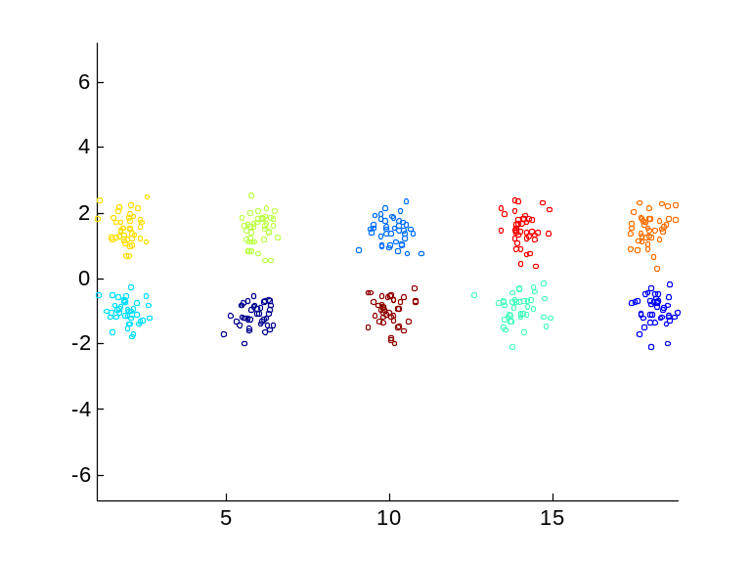
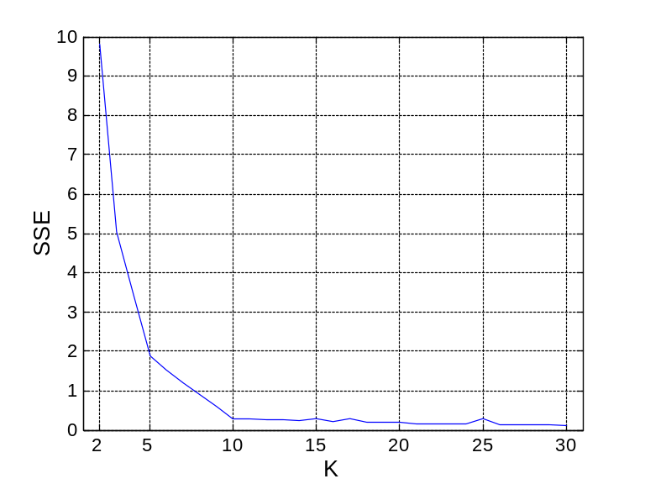
Internal Measures: SSE
Clusters in more complicated figures aren’t well separated
Internal Index: Used to measure the goodness of a clustering structure without respect to external information
  SSE
SSE is good for comparing two clusterings or two clusters (average SSE).
Can also be used to estimate the number of clusters

Slide 7
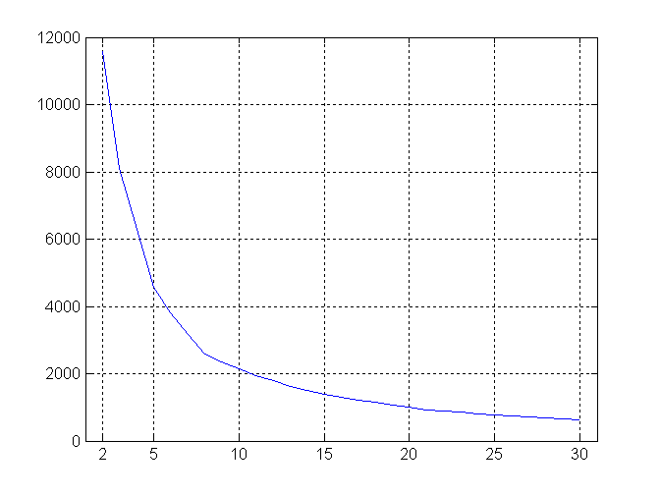
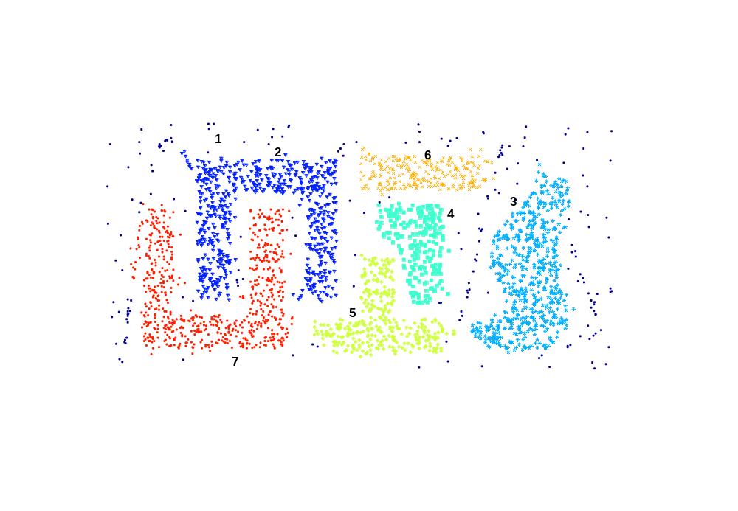
Internal Measures: SSE
SSE curve for a more complicated data set
SSE of clusters found using K-means

Slide 8
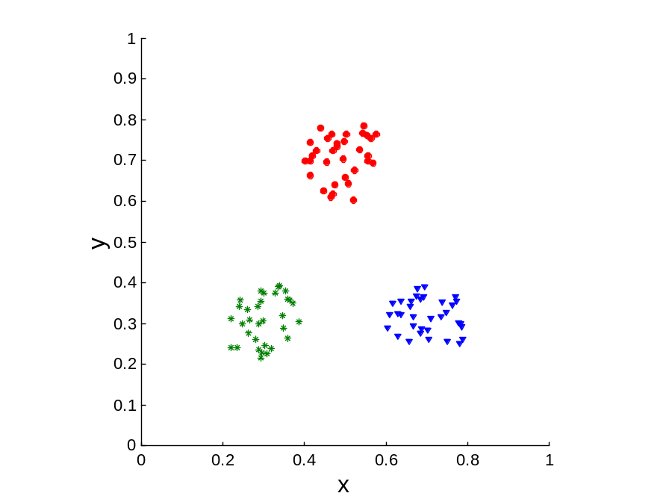
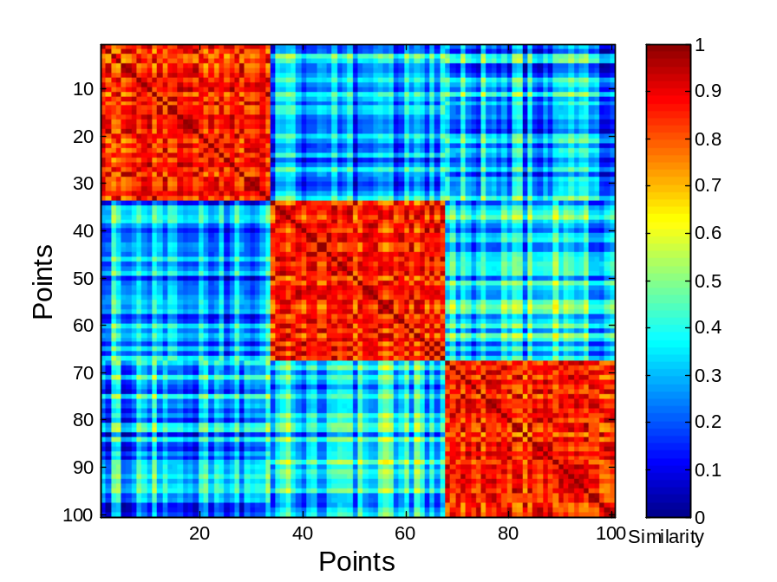
Using Similarity Matrix for Cluster Validation
Order the similarity matrix with respect to cluster labels and inspect visually.

Slide 9
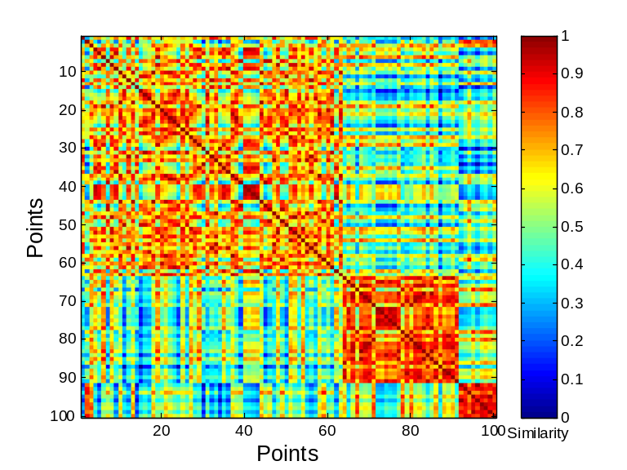
Using Similarity Matrix for Cluster Validation
Clusters in random data are not so crisp
DBSCAN

Slide 10
Final Comment on Cluster Validity
“The validation of clustering structures is the most difficult and frustrating part of cluster analysis.
Without a strong effort in this direction, cluster analysis will remain a black art accessible only to those true believers who have experience and great courage.”
Algorithms for Clustering Data, Jain and Dubes

